Slide 1
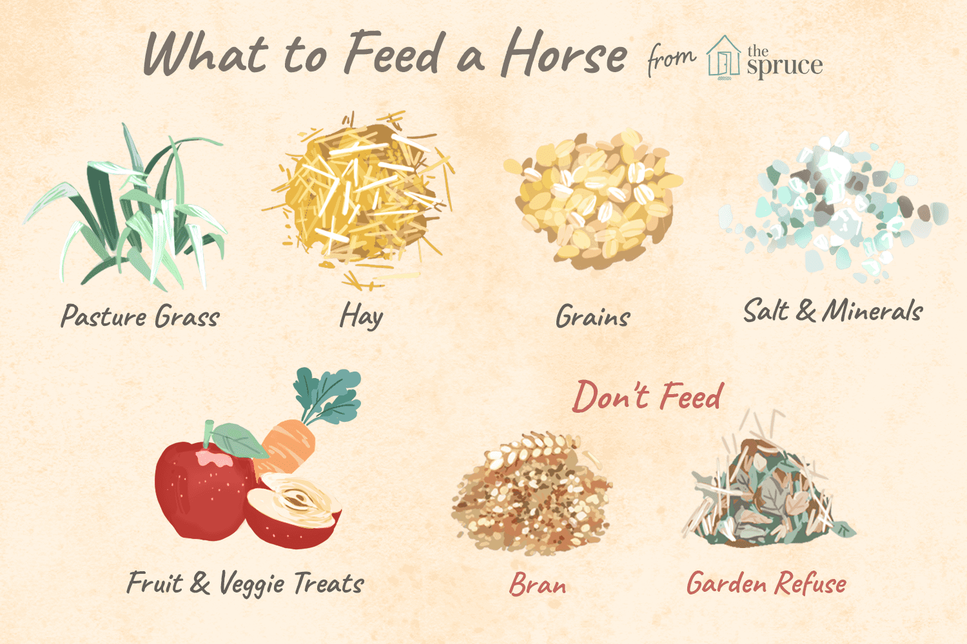
Horse Nutrition
By Cassidy Ranes
Notes:
This is a slid show to see why we feed roughage concentrates and supplements. And to show why we have a feeding cart.

Slide 2
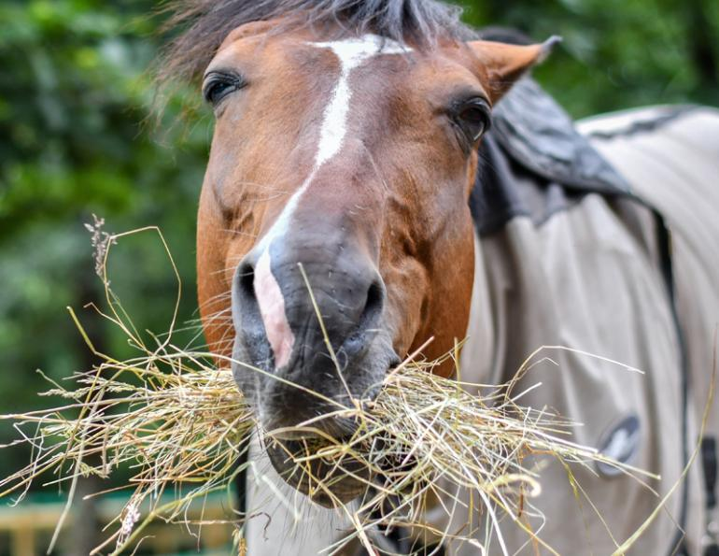
What is nutrition?
Nutrition is what a horse needs or should have to stay healthy. There is Roughage, Concentrates, and Supplements.

Slide 3
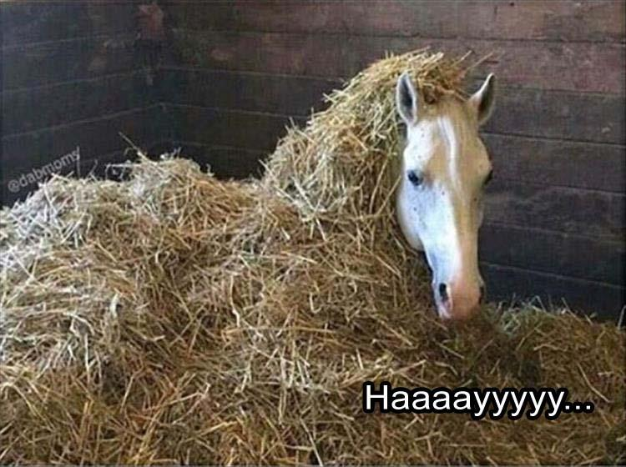
Roughage
Roughage means bulky food like grass, hay, and some special foods such as beet pulp and range cubes. A pony must have plenty of roughage for good digestion.

Slide 4
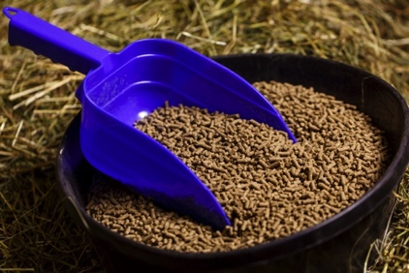
Concentrates
Concentrates are foods that have more food value concentrated in smaller amounts. For ponies, concentrates include grain, mixed feeds, and pellets, and supplements.

Slide 5
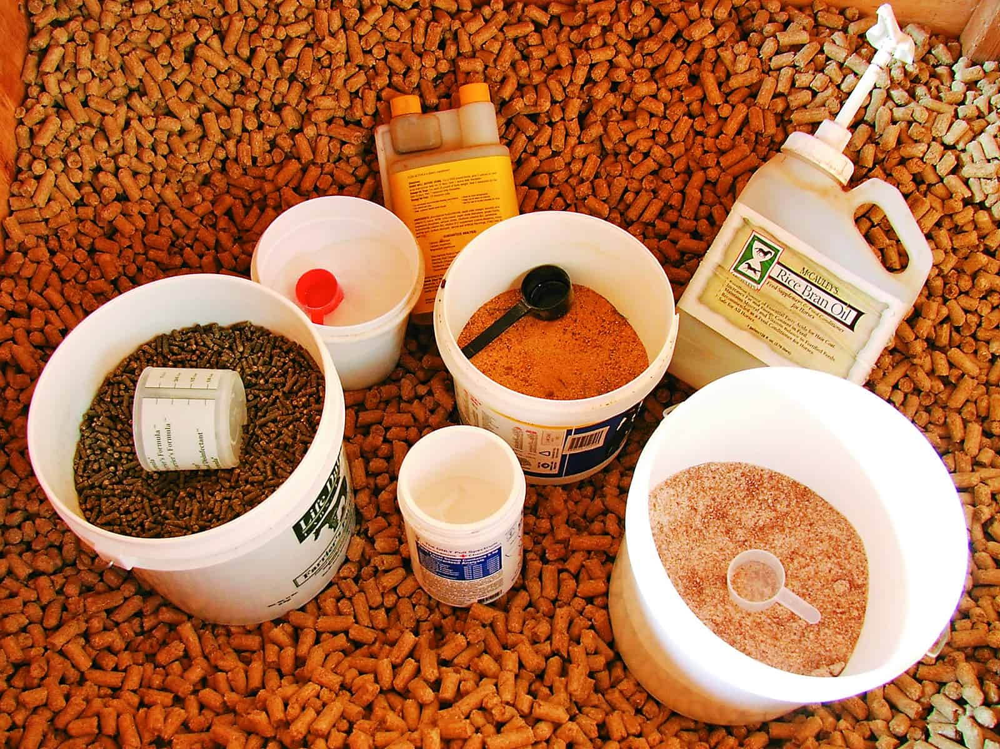
supplements
Whenever a horse can’t get its nutritional needs from eating his pasture grass or normal hay ration, he will need supplements of hay, grain, or both.

Slide 6
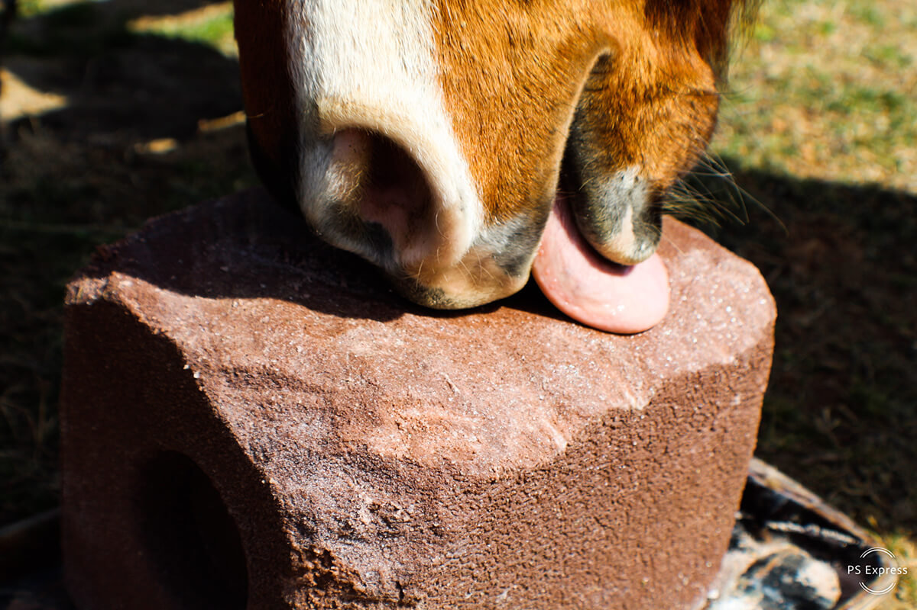
Water & Minerals
Water
Minerals
Constant supply of clean fresh water
Check water supply often in summer to make sure it doesn’t dry up
Break ice in winter
Keep water buckets clean
Salt should always be available as a salt block or loosely

Slide 7
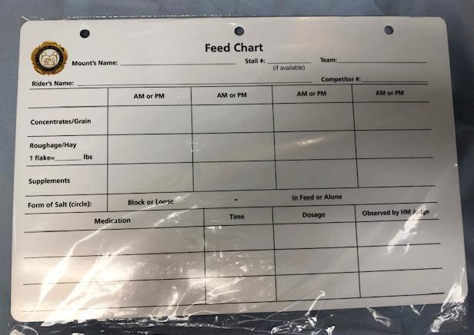
Feeding cart
A horse should have a feeding chart so you know what time it gets feed and what food it needs.

